Slide 1
Architectural risk assessment/analysis
Architectural risk assessment is a risk management process that identifies flaws in a software architecture and determines risks to business information assets that result from those flaws.
Through the process of architectural risk assessment, flaws are found that expose information assets to risk, risks are prioritized based on their impact to the business, mitigations for those risks are developed and implemented, and the software is reassessed to determine the efficacy of the mitigations.

Slide 2
Risk Analysis
Risk analysis is an activity geared towards assessing and analyzing system risks. Risk analysis can be conducted on a scheduled, event-driven, or as needed basis. Risk analysis can be implemented as an iterative process where information collected and analyzed during previous assessments are fed forward into future risk analysis efforts.

Slide 3
Risks
Risk is a product of the probability of a threat exploiting a vulnerability and the impact to the organization.
The process of architecture risk management is the process of identifying those risks in software and then addressing them.
Some complex risks spring to mind easily: a malicious attacker (threat) bypasses the authentication module (vulnerability) and downloads user accounts (information asset), thereby exposing the business to financial liability for the lost records (impact).
It is important to note that the software architecture exists in a system context that includes risks in the physical, network, host, and data layers, and risks in those layers (including those generated outside the organization’s perimeter) may cascade into the software architecture.

Slide 4
Mitigations
Risk mitigation refers to the process of prioritizing, implementing, and maintaining the appropriate risk-reducing measures recommended from the risk analysis process.
Mitigating a risk means changing the architecture of the software or the business in one or more ways to reduce the likelihood or the impact of the risk.
A mitigation consists of one or more controls whose purpose is to prevent a successful attack against the software architecture’s confidentiality, integrity, and availability

Slide 5
Architectural Risk Management
Risk management is the process of continually assessing and addressing risk throughout the life of the software.
It encompasses four processes: (1) asset identification, (2) risk analysis, (3) risk mitigation, and (4) risk management and measurement.
During each of these phases, business impact is the guiding factor for risk analysis. The architectural risk analysis process includes identification and evaluation of risks and risk impacts and recommendation of risk-reducing measures

Slide 6
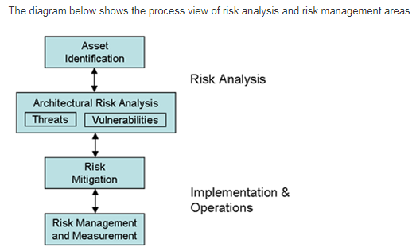

Slide 7
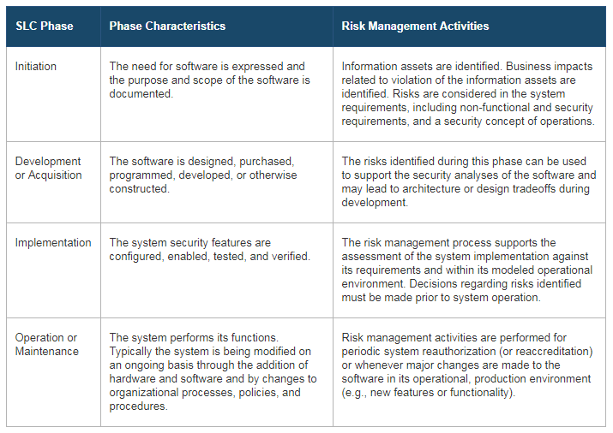

Slide 8
Risk management
Process of: assessing risk, taking steps to reduce it to an acceptable level, and maintaining that level of risk
Five principle:
I. Assess risk and determine needs
Recognize the importance of protecting information resource assets
Develop risk assessment procedures that link IA to business needs
Hold programs and managers accountable
Manage risk on a continuing basis
II. Establish a central management focus
Designate a central group for key activities
Provide independent access to senior executives to the group
Designate dedicated funding and staff
Periodically, enhance staff technical skills

Slide 9
III. Implement appropriate policies and related controls
Link policies to business risks
Differentiate policies and guidelines
Support polices via the central IA group
IV Promote awareness
Educate user and others on risks and related policies
Use attention-getting and user-friendly techniques
V Monitor and evaluate policy and control effectiveness
Monitor factor that affect risk and indicate IA effectiveness
Use results to direct future efforts and hold managers accountable
Be on the lookout for new monitoring tools and techniques

